Slide 1
Employee Attrition Analysis
By – Md Parwez Alam

Slide 2
Introduction
XYZ company which was established a few years back is facing around a 15% attrition rate for
a couple of years. And it's majorly affecting the company in many aspects. In order to
understand why employees are leaving the company and reduce the attrition rate XYZ
company has approached an HR analytics consultancy for analyzing the data they have. You
are playing the HR analyst role in this project and building a dashboard which can help the
organization in making data-driven decisions.

Slide 3
Details of Data
.
Importing and verifying data. few transformations and cleaning in power query 2) Data modeling 3) Identifying & Creating Measures using DAX. 4) Validating all data 5) Creating Dashboard using appropriate Visualization.
Visualization Tool : Power Bi Database : Excel
.

Slide 4
Main KPIs
Employee Count – Average Count Per Employee
Average Age – Age of Per Employee
Average Year – Number of Year of Per Employee
Average Salary –Salary of Per Employee
Average Salary – Salary Based on Perform of Per Employee

Slide 5
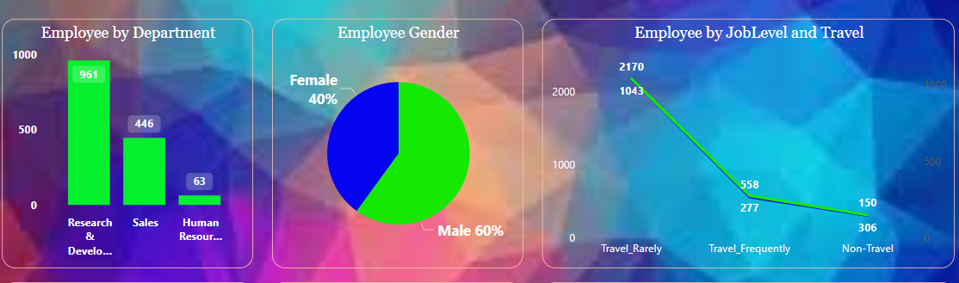
My Design

Slide 6
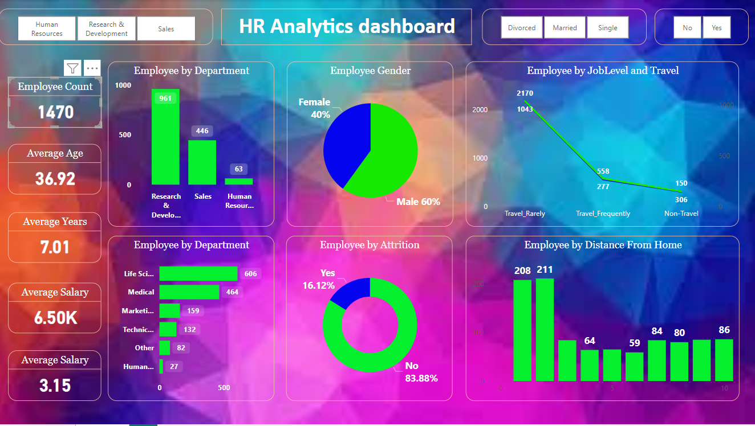
Dashboard

Slide 7
Thank you

